Slide 1

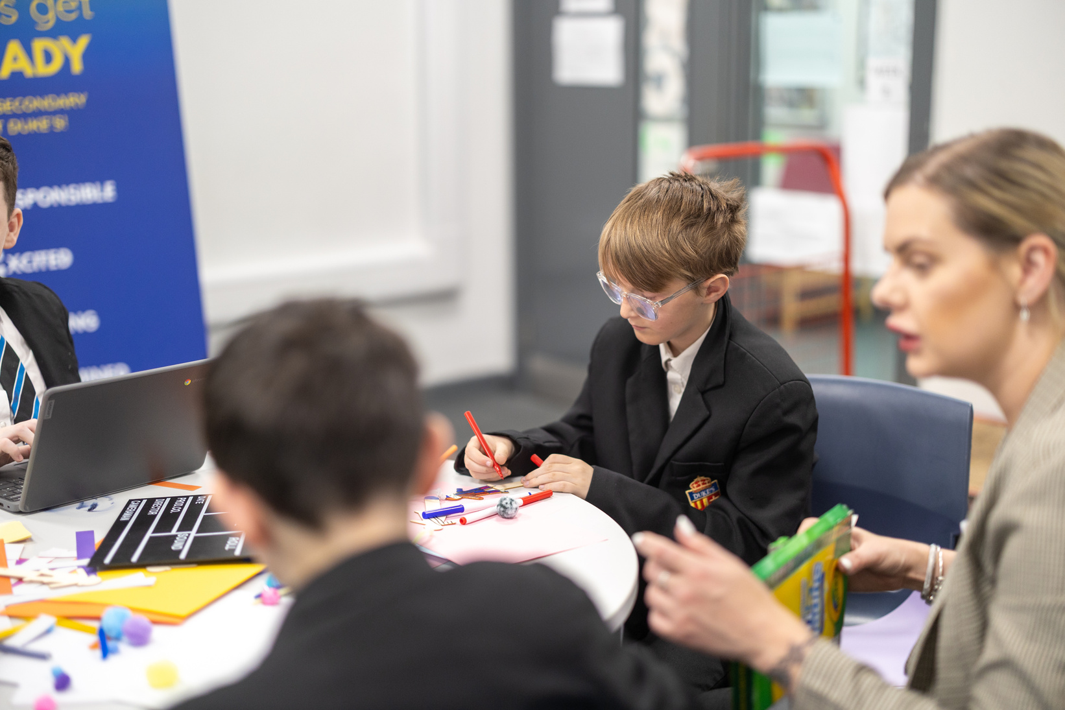


KEY+ IN EDUCATION
MEASURING IMPACT
Notes:
While impact information on confident and movement in skills development can be found on KIT once all information is completed, there are other ways to measure impact throughout the project.

Slide 2
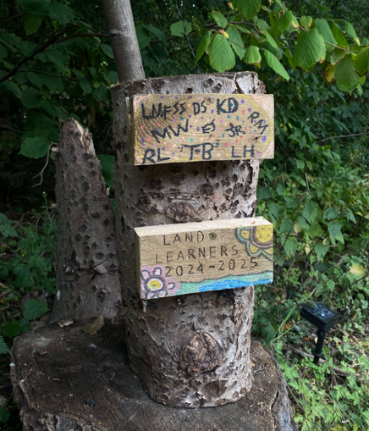

CONTENTS
3
4-8
9-12
13-16
17-20
21-23
24
List of impact measurement tools
Rating Friendships
Rating Confidence
Check In/Out
Traffic Light System
Capturing Impact
The Key Contacts

Slide 3
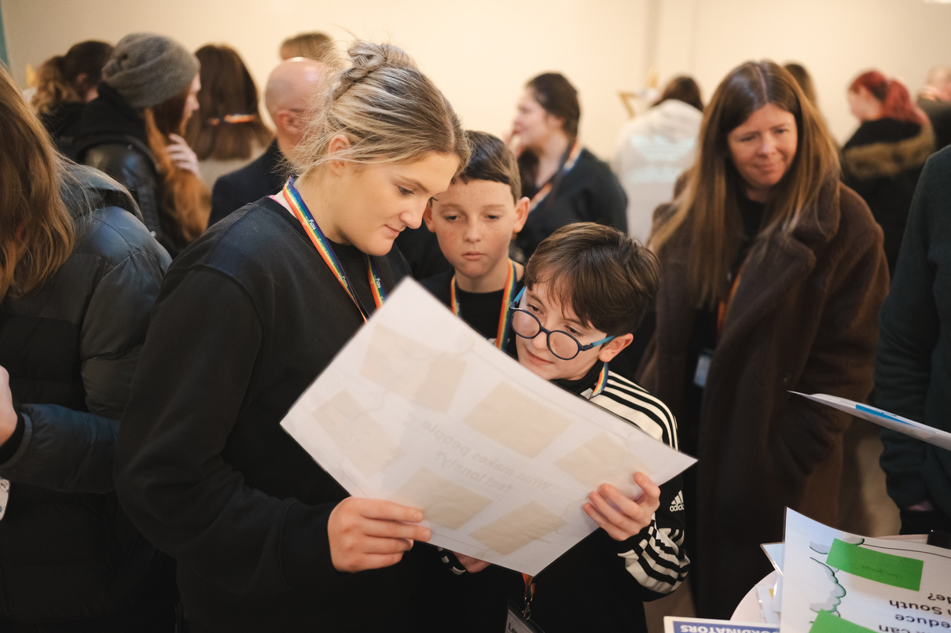
USEFUL IMPACT TOOLS
These slides introduce a range of practical impact tools designed to help facilitators capture meaningful change and measure the growth, progress, and outcomes achieved throughout KEY+ sessions.
  Rating Friendships
  Rating Confidence
  Check In & Out of Sessions
  Traffic Light System
  Capture Impact (after every session)
Notes:
These are suggestions of ways to collect impact data, should your school require it to give the KEY+ programme validation.
You do not need to do all or any of these, but capturing impact is a great way to support the young people to show them how much progress they have made as well as being evidence for the senior leadership team.

Slide 4
RATING FRIENDSHIPS
Notes:
The next few slides are on rating friendships.

Slide 5

RATE FRIENDSHIPS & CONFIDENCE
Help young people reflect on their friendships and confidence levels across the KEY+ Challenge.
1
Guidance
Ask young people to rate their friendships and confidence at the beginning of KEY+. Encourage them to think about whether they have a group of friends and the quality of those friendships.
Encourage them to think about what they feel confident doing:
  On their own
  With a friend
  In a small grup
  In a class
  In a whole year
What a Healthy Friendship Looks Like
  Friends can be different people at different times
  They listen, notice things about you, and show interest
  They do things for you willingly, without expecting anything back
  You can have fun and laugh together
  You enjoy spending time with them because they make you feel good about yourself
  They don’t pressure you to do things you don’t want to do; they respect your choices
  They value your opinion and understand when you feel sad
Notes:
Rating friendships is a way to show the young people how they have developed over the course of the programme. It's important to remind them that there will be ups and downs, but throughout the programme, they might learn different ways to deal with challenging situations and build their support network.
These slides can help the young people to understand how they will rate themselves.

Slide 6
THE FRIENDSHIP QUALITIES SCALE
1
The Friendship Quality Scale helps young people think about what makes a friendship healthy by breaking it down into simple areas they can recognise and talk about.
The Friendship Quality Scale - Areas
  Companionship: Enjoying spending time together and taking part in activities you both like.
  Conflict: How disagreements are handled and whether friends can sort things out respectfully.
  Closeness: The emotional connection between friends, including trust, comfort, and being able to share feelings.
  Support: Being there for each other, offering help and kindness during difficult moments.
  Security: Feeling safe in the friendship, knowing you can rely on each other and be yourself.
Notes:
The Friendship Qualities Scale was developed by Bukowski, Hoza, and Boivin in 1994 to evaluate the friendships among children and adolescents. It measures various aspects of friendships through a structured questionnaire, providing insights into the dynamics of these relationships.
You can use this to help young people to understand the different aspects to friendships.

Slide 7





RATING FRIENDSHIP
Here is how to help young people rate each part of their friendships so they can reflect on what’s working well and what could be improved.
1
Young people can complete this quiz at the start of the challenge and repeat it at the end, allowing you to compare their scores and see how their friendships have developed over time.
The Friendship Quality Scale - Ratings
  Companionship: You enjoy spending time together doing the same things
  Conflict: You rarely fall out, but if you do, you settle disagreements quickly
  Closeness: You tell each other everything and have a strong intimate bond.
  Support: You’re always there to help and support each other, no matter what.
  Security: You ALWAYS trust each other 100%, feel safe and can rely on each other to have their back.
Strongly Disagree
1
Disagree
Neutral
Agree
Strongly Agree
2
3
4
5
Notes:
Using the FQS young people can rate their friendships: choose whether to strongly agree, agree, neither agree or disagree, disagree or strongly disagree with the friendship qualities based on your friendships.
Scoring: Add up your total out of 25
Strongly Agree - 5
Agree - 4
Neither Agree or Disagree - 3
Disagree - 2
Strongly Disagree - 1

Slide 8
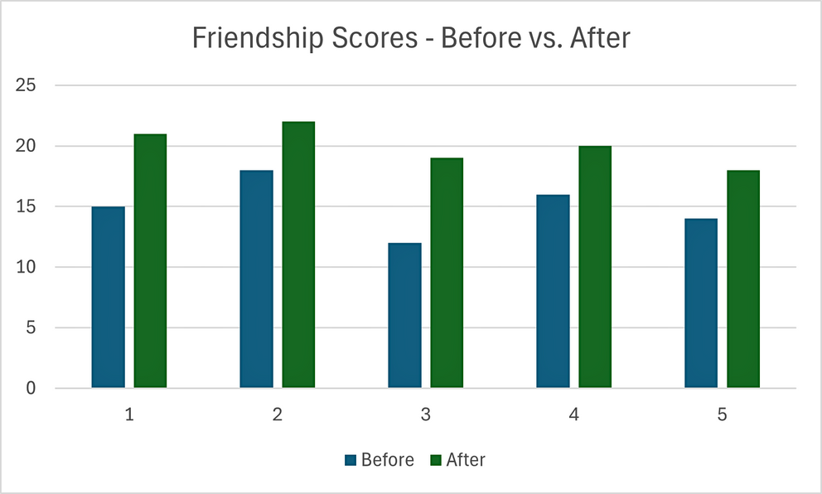
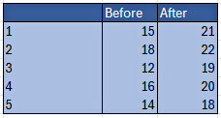
EXAMPLE FRIENDSHIP SCORES
Using the data:
  Take all the Before scores for each individual young person and sum them.
  Take all the After scores for each individual young person and sum them.
  Use a bar chart (side-by-side bar chart) to give a quick visual snapshot of progress.
This method of analysing the data is the best option because it gives insight into overall friendship growth without overwhelming detail.
Example Graph with data from 5 Young People- Before and After:
*You can use the names of the young people, or make the data anonymous by numbering them
Notes:
If you use a simple Excel spreadsheet to capture the ratings, you can produce a chart as a visual tool for SLT or the young people to see where they have grown.

Slide 9
RATING CONFIDENCE
Notes:
The next few slides are on rating confidence.

Slide 10

RATING CONFIDENCE
2
Confidence is a key part of personal and social development. Here’s why measuring it is important:
Measuring confidence helps facilitators understand how young people feel about themselves and their abilities. It also allows you to track growth over the course of the KEY+ Challenge and identify areas where support might be needed.
Confidence Ratings
1 = Very low/poor confidence
2 = Low confidence
3 = Average confidence
4 = High/good confidence
5 = Very high/excellent confidence
Collect scores at the start and the end of the KEY+ Challenge and compare before and after scores to see changes in confidence.
Notes:
Rating confidence is a way to show the young people how they have developed over the course of the programme. It's important to remind them that there will be ups and downs, but throughout the programme, they might learn different ways to deal with challenging situations and build their support network.
These slides can help the young people to understand how they will rate themselves.
Using a similar likert scale, explain to the young people that they can rate their confidence at the beginning and end of the KEY+ Challenge.

Slide 11
CONFIDENCE SCALES
2
Thinking about these situations, rate your confidence on a scale of 1-5, where 1 is very low and 5 is very high.
Situations
Talking to someone I don’t know on the phone
Talking to someone in a position of power and authority
Doing a presentation in front of 2-3 people I don’t know
Going somewhere I’ve never been before
Doing something I’ve never done before
Notes:
Encourage the young people to rate themselves using the 5-point confidence system for each of these statements, then add up their total score out of 25.

Slide 12
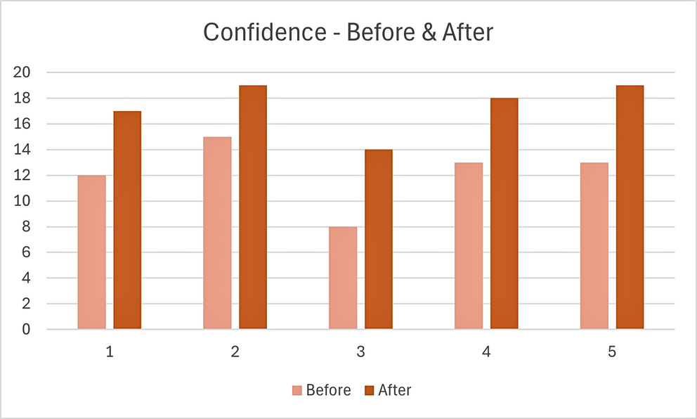
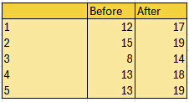
EXAMPLE CONFIDENCE SCORES
Using the data:
  Take all the Before scores for each individual young person and sum them.
  Take all the After scores for each individual young person and sum them.
  Use a bar chart (side-by-side bar chart) to give a quick visual snapshot of progress.
This method of analysing the data is the best option because it a general overview into confidence growth over the course of the project.
Example Graph with data from 5 Young People- Before and After:
*You can use the names of the young people, or make the data anonymous by numbering them
Notes:
Record their scores on a simple Excel spreadsheet at the beginning and end of the programme and create a graph for a visual tool to show the young people and SLT their growth.

Slide 13
CHECK IN/
OUT
Notes:
These slides are on measuring impact through checking in/out.

Slide 14

CHECK IN AND CHECK OUT - NUMBERS
The purpose of checking in and checking out is to help young people reflect on how they are feeling at the start and end of each session, notice any changes, and consider what influences their mood and how they might improve it.
The check in/out tool is also useful to support facilitators to be mindful in how to deliver a session.
3
Check-In (Start of Every Session)
  Ask young people to rate how they are feeling in that moment on a number scale 1-10 (1 = worst ever, 10 = best ever)
  Encourage the young people to think about why they feel that way.
Check-Out (End of Every Session)
  Repeat the rating at the end of the session.
Encourage reflection:
  Has the score increased, decreased, or stayed the same?
  Why do they feel this way?
  If the score is still low, what could they do to increase it?
1
2
3
4
5
6
7
8
10
Really bad
Meh
Not great but hopeful
Okay but could be better
Pretty good
The best!
Notes:
Benefits of checking in and checking out, using the number scale, include:
Giving the young people the opportunity to let you know where their head is at
Knowing how much to expect from the young people over the session and what delivery style will work best
It can be useful, after the session (not in front of the YP) to keep a record of the scores or any changes to keep a check on whether a YP regularly feels very low or if they are finding the sessions challenging.
To help explain the numbers, use some examples as shown at the bottom of this slide.
It can be helpful as a facilitator to join in - it can be particularly useful to demonstrate that we all have days where we are feeling lower, or if something good/bad has happened, it's a good way to model this for the young people.

Slide 15
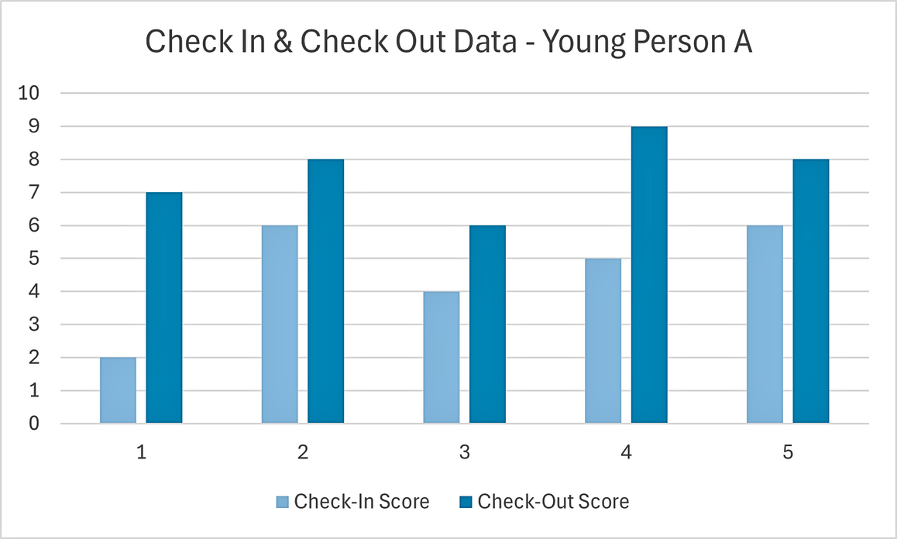
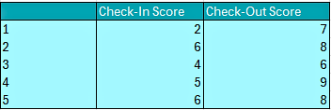
EXAMPLE CHECK IN/OUT SCORES
Using the data: This graph will show that, for example, some sessions may start lower and end higher, showing growth and impact of the specific session activities.
Example Graph with data from one young person:
*You can use the names of the young people, or make the data anonymous by numbering them but it is important this information is kept personal and private to the facilitator and the young person - it must not be shared.
Notes:
If you record the data on a simple Excel spreadsheet, you can create a visual tool which might be helpful as a facilitator or for SLT.

Slide 16
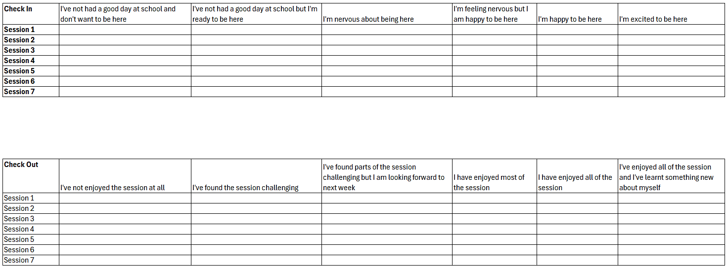







CHECK IN AND CHECK OUT - EMOJIS
3
Some young people find pictures and descriptions easier to process. You can use the same methods from the number check-in/out but with emojis instead!
Notes:
Similar to the check in/out numbers, the emojis and feelings descriptions can be tweaked to fit what the facilitator is trying to capture.
The sheet should be kept personal to the young person and could be kept inside the workbook for the facilitator to access as/when needed.

Slide 17
TRAFFIC LIGHT SYSTEM
Notes:
The next few slides explain the traffic light system for measuring impact.

Slide 18

TRAFFIC LIGHT SYSTEM
4
The Traffic Light System is a visual tool to track young people’s progress and identify areas where support is needed.
Benefits:
  Updating the Excel sheet regularly allows facilitators to quickly see patterns and highlight areas of improvement.
  This system supports facilitators in planning interventions, allocating resources, and celebrating achievements.
  By using traffic light coding, facilitators can provide targeted support to each young person according to their individual needs.
How to Use:
Facilitators can use an Excel sheet to list young people’s names alongside their learning targets or goals.
Each target is assigned a colour based on progress:
  Red = The young person is struggling and requires focused support
  Amber = The young person is making progress but still needs guidance.
  Green = The young person has achieved the target!
Notes:
One school who have delivered the KEY+ Challenge for a number of years have developed a set of traffic light impact measurement systems to support young people to achieve some of the targets set in school.
You can use your own be-spoke targets or areas to add to a list to support young people to grow and develop.

Slide 19
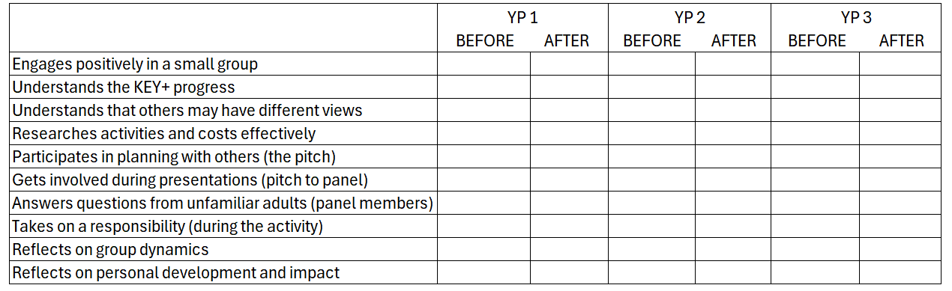
TRAFFIC LIGHT - SUGGESTED TARGETS
Notes:
These targets are quite generic and can be tweaked or changed to meet the needs of individual schools.

Slide 20
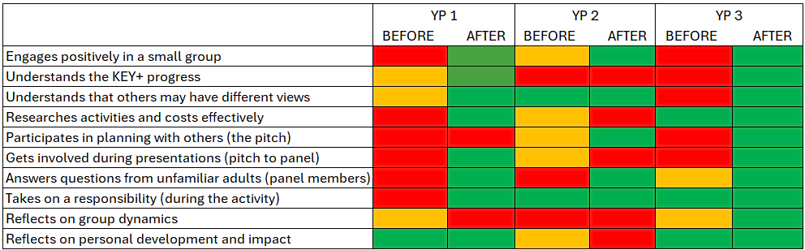
TRAFFIC LIGHT EXAMPLE
Notes:
What a completed traffic light system might look like.

Slide 21
CAPTURING IMPACT
Notes:
The next few slides describe how to capture impact after every session to identify areas of development or gaps in skills.

Slide 22

5
CAPTURING IMPACT
The method of capturing impact at the end of every session by reflecting on skills, is effective because it captures both self-reported skill usage and observable improvement, helping facilitators identify which skills are developing most strongly and where support may be needed.
Step-by-Step Instructions:
  Create a table showing each skill and the number of young people who reported using it.
  At the end of each session, ask participants which skills they feel they used.
  Get the young people to write down whether they identified with each skill (Y/N).
  Analyse the the table to see which skills are used most often.
  Check if the skills most frequently used are also the ones that have improved the most over time.
Notes:
This can support a facilitator to identify areas of development or gaps in skills.
Record the number of young people in each session who report using particular skills.
Support the young people to know which skills they have used by asking questions like:
When you telephoned the venue which skills did you use?
What other skills did you use?
When you used the internet what skills were you using?
Did you take responsibility for that as part of the team?
Did you have to make any decisions while you were doing that?

Slide 23
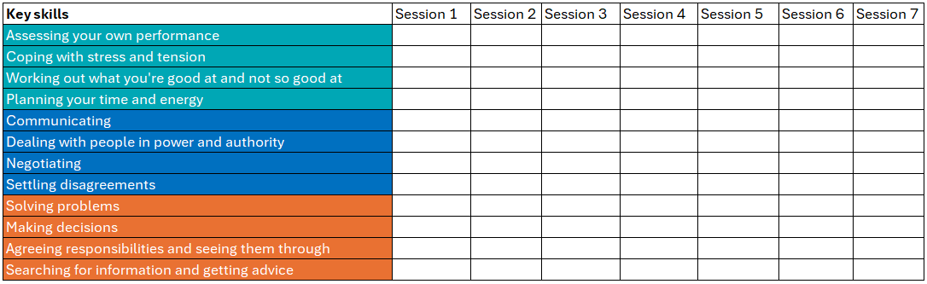
CAPTURING IMPACT - TRACKING KEY SKILLS
Notes:
Record the number of young people in each session who report using particular skills.
Support the young people to know which skills they have used by asking questions like:
When you telephoned the venue which skills did you use?
What other skills did you use?
When you used the internet what skills were you using?
Did you take responsibility for that as part of the team?
Did you have to make any decisions while you were doing that?

Slide 24
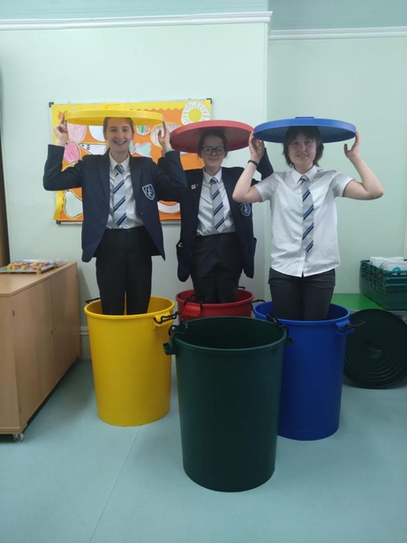
KEY CONTACTS
Leah Roberts: leah@thekeyuk.org
Jack MacKenzie: jack@thekeyuk.org
Sari Sokell: sari@thekeyuk.org
thekeyuk.org
Notes:
Please get in touch with The Key staff for any questions, queries or support needs.

