Slide 1

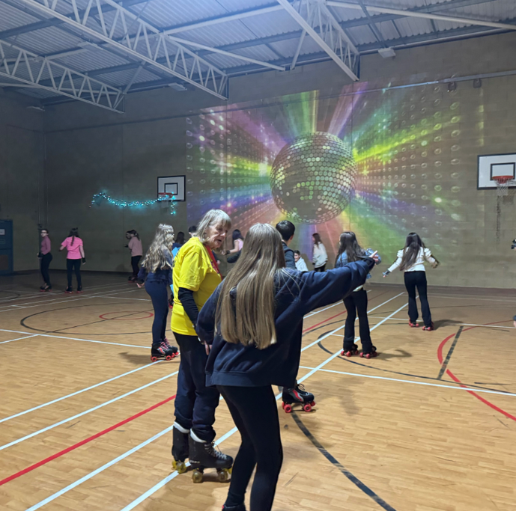
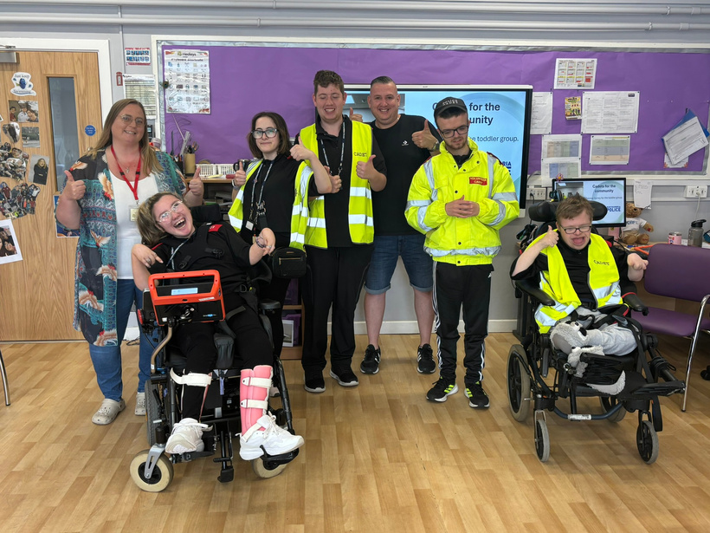


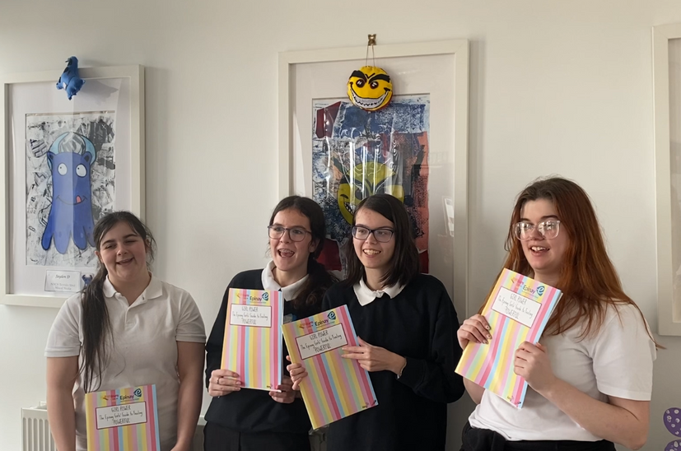
KEY+ IN EDUCATION
Skills. Confidence. Resilience

Slide 2
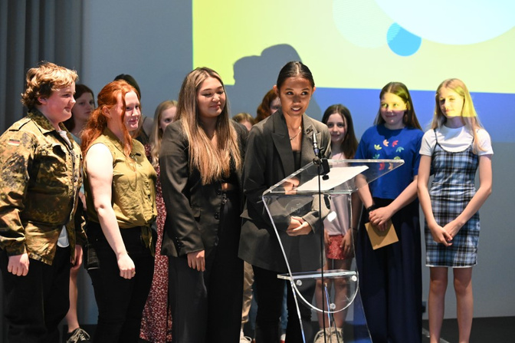

CONTENTS
3-6
7-18
19-26
27-33
34-40
41-42
43-48
49
An introduction to KEY+
Introduction & Icebreakers
Think Stage
Plan Stage
Pitch Stage
Do Stage
Review Stage
Key Contacts

Slide 3
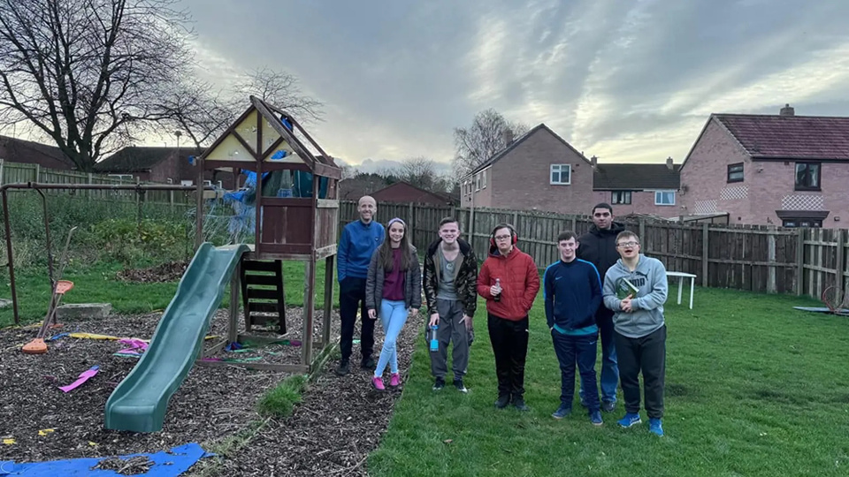



WHO WE ARE
The Key empowers young people across the North East of England, particularly those growing up in poverty and those facing challenging personal circumstances. Through our proven approach, young people shape their own futures.
Vision
A future where all young people believe in themselves, unlock their potential, and lead connected and fulfilling lives.
Mission
We work in collaboration to provide young people with meaningful and impactful opportunities to develop skills, build confidence, and grow resilience.
Values
FOCUS
We keep sight of the goal
COLLABORATION
We work together
to achieve common objectives
GROWTH
We constantly strive to be the best we can be
Everything we do is for the benefit of young people
Notes:
A brief introduction to The Key and what our vision and mission is.

Slide 4








OUR BELIEFS
LEAD PROJECTS & ACTIVITIES THAT MATTER
TO THEM
BE ACTIVE CITIZENS BY EXPLORING ENTERPRISE OR TACKLING
SOCIAL ISSUES
VOICE
USE THEIR VOICE &
BE HEARD
BUILD SKILLS, CONFIDENCE & RESILIENCE TO THRIVE
Notes:
Some more information about The Key.

Slide 5
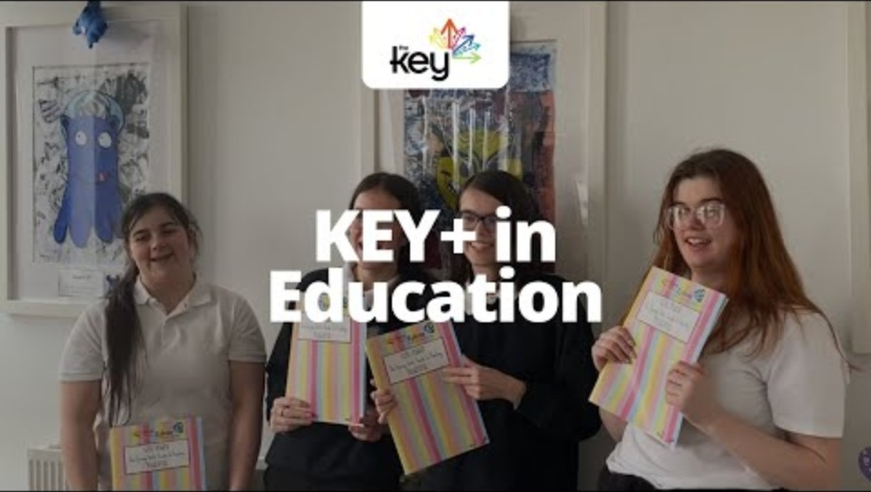
KEY+ IN EDUCATION
Notes:
Use this video to introduce the young people to the KEY+ Challenge and The Key as an organisation.

Slide 6
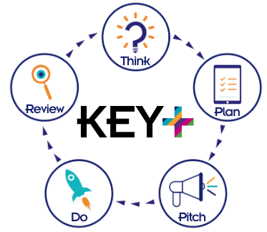



THE KEY+ CHALLENGE
+
K
E
Y
+ FOLLOW ON OPPORTUNITIES
KICKSTART SKILLS
EXCEED
EXPECTATIONS
YOUTH
IMPACT
Continued growth through bespoke opportunities, work experience or volunteering.
Young people get to grips with the five step challenge
Challenges
them further with a bigger project
Focuses on
enterprise or
social action
£250
Stage 1
£500
Stage 2
£1,000
Stage 3
Notes:
The 5 steps of the KEY+ Challenge guides to guide students and facilitators through the programme (left).
The 3 stages of the KEY+ Challenge structure the programme helping students to build skills and achieve outcomes at different levels (right).

Slide 7
ICEBREAKERS
Notes:
While you may feel that the young people already know each other and there is 'no need' for icebreakers, it is important to prioritise an informal approach and include an icebreaker at the beginning of the first session (and repeatedly during other sessions if needed). This is a good way of helping the group to know this is a more relaxed environment than the classroom, it can also help them to be focused and get them talking to each other.
It is important to ensure that icebreakers are used in a sensitive and fun way, to help young people feel at ease and encourage them to get creative.
Encourage young people to take charge right from the very beginning and let them choose the icebreaker from a list! The icebreakers are explained in more detail across the next 10 slides - use them as and when you feel you might need to.

Slide 8
GETTING TO KNOW EACHOTHER
Choose one activity as an ice-breaker.
Wink murder
Fork game
Picture prompt
SPLAT
Drawing game
“I” statements
This or that
Would you rather
Notes:
While you may feel that the young people already know each other and there is 'no need' for icebreakers, it is important to prioritise an informal approach and include an icebreaker at the beginning of the first session (and repeatedly during other sessions if needed). This is a good way of helping the group to know this is a more relaxed environment than the classroom, it can also help them to be focused and get them talking to each other.
It is important to ensure that icebreakers are used in a sensitive and fun way, to help young people feel at ease and encourage them to get creative.
Encourage young people to take charge right from the very beginning and let them choose the icebreaker from a list! The icebreakers are explained in more detail across the next 10 slides - use them as and when you feel you might need to.

Slide 9

SPLAT
SPLAT is a fast-paced, high-energy circle game where quick reactions are key! The aim is simple: don’t get “splatted” before you can splat someone else!
How it works
  Gather your group in a circle with one person standing in the middle as the Splat Master.
  The Splat Master points dramatically at someone and yells “SPLAT!”
  That player must instantly duck, while the two people beside them try to splat each other by pointing and shouting “SPLAT!” first.
  The slower splatter is out and steps out of the circle.
  The Splat Master keeps firing off splats, twists, turns, and fake-outs to keep everyone on their toes!
How to win
  Keep reacting lightning-fast and avoid elimination.
  The last player standing in the circle becomes the Ultimate Splat Champion!
Notes:
These slides are intended as a guide, and you can choose whether to include them or just use them for guidance.

Slide 10

WINK MURDER
Wink Murder is a sneaky, suspense-filled game where one secret killer “winks” their way to victory - the aim is to spot the murderer before they silently take everyone out!
How it works
  Gather your group in a circle and choose a detective. Then send the detective out of the room so you can choose your murderer!
  Bring the detective back in and the game begins.
  Everyone else keeps a straight face while the Murderer tries to “kill” players by giving them a quick, sneaky wink.
  If you’re winked at, you must dramatically (or subtly) “die” and drop out of the game.
  Survivors watch closely and try not to get caught making eye contact!
How to win
  If you’re the detective: correctly accuse the Murderer within 3 guesses (or more/less depending on group size). Or before the Murderer kills everyone.
  If you’re the Murderer: eliminate everyone without getting spotted - and enjoy the chaos!
Notes:
This game is best played with at least 5-6 young people.

Slide 11
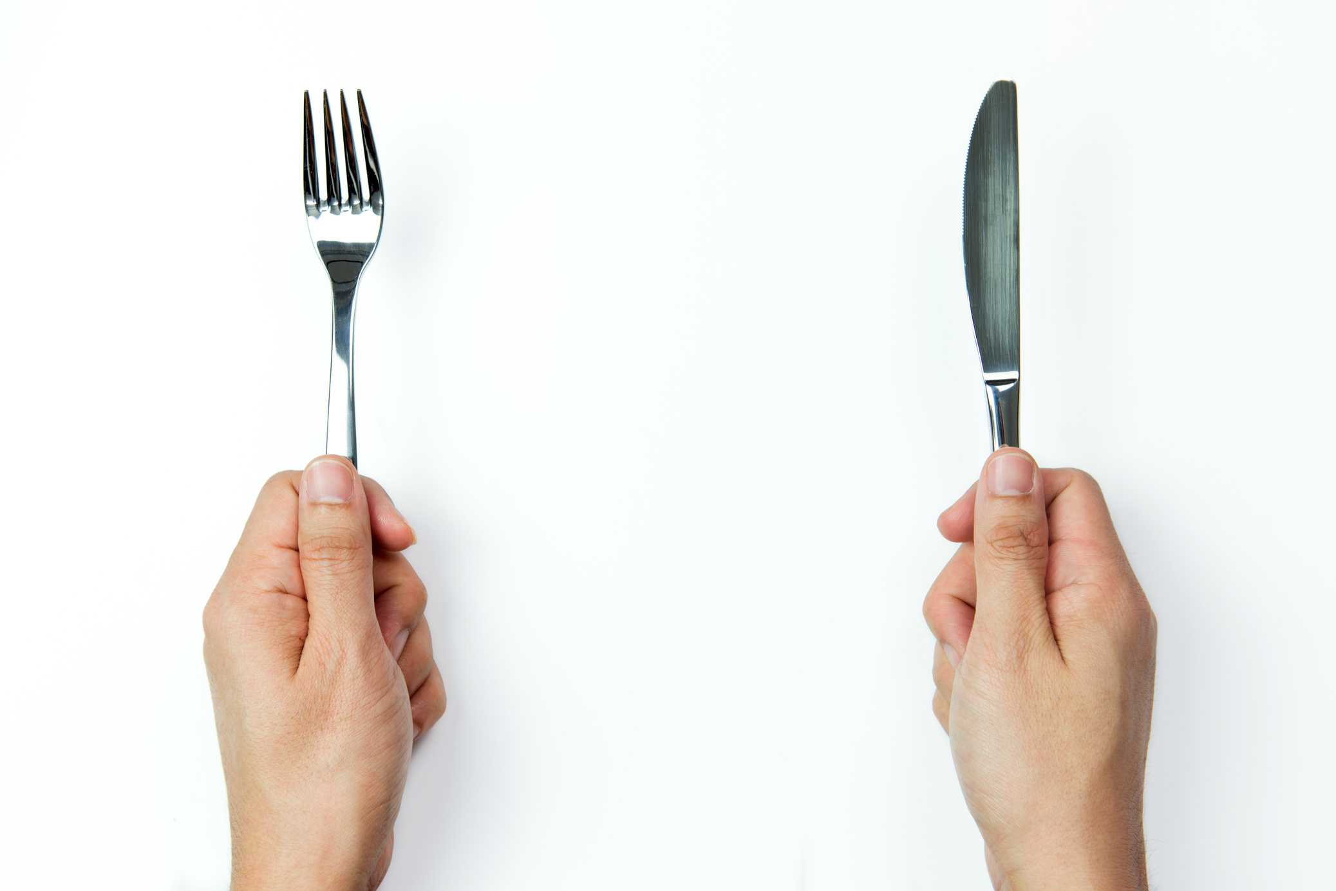
FORK GAME
The Fork Game breaks the ice, boosts creativity, and helps young people feel more relaxed and confident speaking in front of each other.
How it works
  Show the group a fork (or any simple object).
  Explain that each person must come up with a different, creative use for the object.
  When it’s their turn, they hold the object and start their idea with: “I would use it to/for...”
  Encourage imaginative, funny or unusual ideas - the more creative, the better.
  With smaller groups, you can go round more than once.
  To add a challenge: the group cannot use the object for its intended purpose.
Notes:
Requires a fork or another everyday object...
Suggestions for other objects:
Toothbrush
Glass
Toilet roll
Wooden spoon
Washing up sponge
Garlic press

Slide 12

PICTURE PROMPT
Picture Prompt gets young people talking, builds confidence, and encourages creative thinking - all while helping the group feel more relaxed and engaged.
How it works
  Show the group a random picture (this can be a photo, illustration, meme-style image, or something abstract).
  Ask each young person to describe what they think is happening in the picture.
  Encourage them to be creative, humorous or imaginative in their responses.
Different variations
  “Give this picture a title.”
  “What happened 5 minutes before this picture was taken?”
  “What happens next?”
  “Describe this scene in one sentence.”
Notes:
Print off the pictures on the slides and cut them up.
Place them on the table and ask the young people to think about which one they are drawn to. Take turns to go round the group and say which one they have chosen and why.
Feel free to add to the pictures or ask the young people if there are any pictures missing.
This activity can help the young people to find out about similarities or differences they may have.

Slide 13
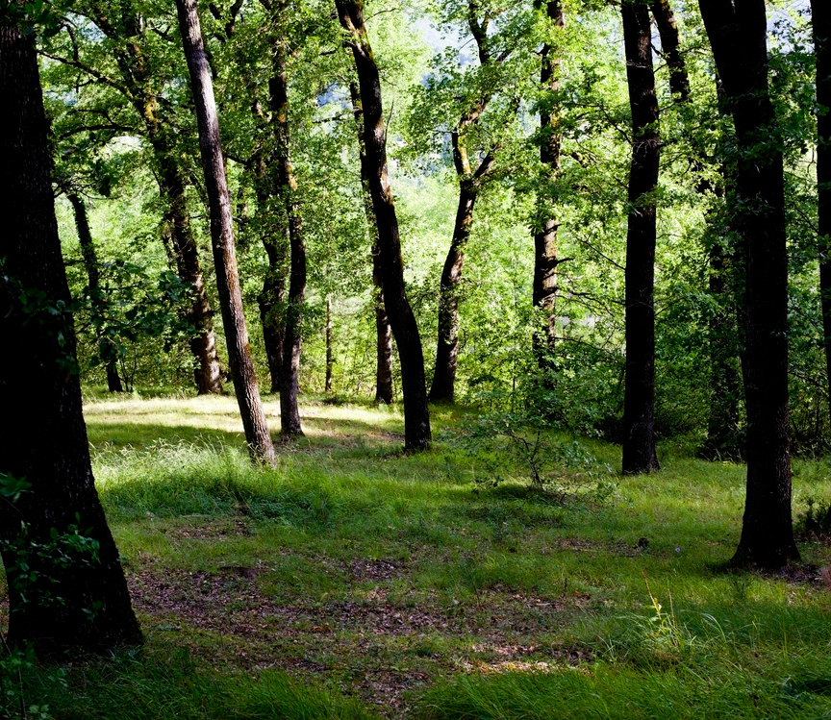



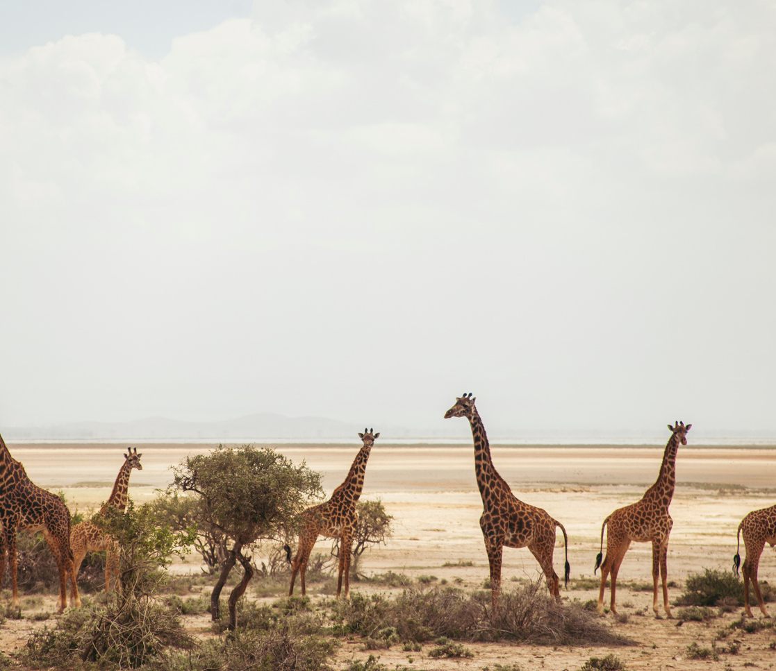

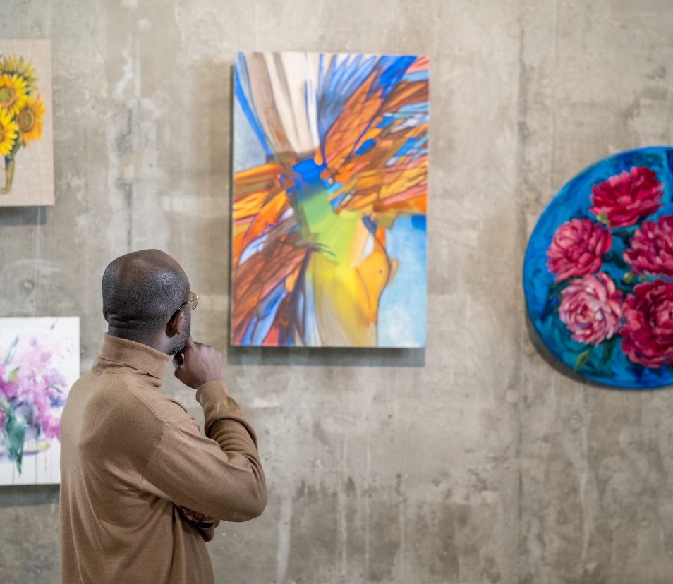

PICTURE PROMPT IDEAS
Notes:
Print off the pictures on the slides and cut them up.
Place them on the table and ask the young people to think about which one they are drawn to. Take turns to go round the group and say which one they have chosen and why.
Feel free to add to the pictures or ask the young people if there are any pictures missing.
This activity can help the young people to find out about similarities or differences they may have.

Slide 14
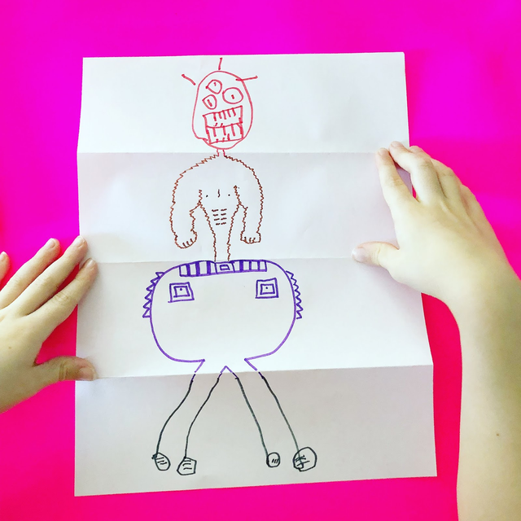
DRAWING GAME
The Drawing Game is a hilarious, creative art challenge where everyone adds a section to a mystery character.
How to play
  Give each player a A4 sheet in portrait orientation.
  Fold it in half top-to-bottom, then fold it again the same way; open it out so there are 4 equal sections.
  Everyone draws a head in the top section.
  Fold the paper over so only the connecting neck lines show, then pass it to the next person.
  That person draws a body, folds it over, and passes it on.
  Next person draws legs, folds, passes.
  Next person draws feet, folds, passes.
  The final person opens the masterpiece, gives the character a name and reveals it to the group!
Notes:
The number of people doesn't matter for this activity, sometimes it will end up back where it started, other times it won't make it all the way round the group.
It's important to remind the young people to make sure the lines are visible on the folded piece of paper for the next person to see.
It's good for facilitators to join in with this game and keep the anticipation building - don't let anyone else see what you're drawing!

Slide 15

“I LIKE” STATEMENTS
“I” statements is a warm, feel-good sharing game where everyone gets to express what they enjoy.
How to play
  Bring the group together in a circle or comfy space.
  Invite each person, one at a time, to finish the sentence “I like...” with something they enjoy, love, or are interested in.
  Encourage variety - hobbies, food, places, people, experiences, anything!
  Keep the circle going for as many rounds as you like!
Examples
  Playing board games
  Hot chocolate
  Dogs
  The beach
  Being with my family
  School
  To be outdoors
  Pizza with pineapple
  Talking to people
  Dancing
  Football
  Listening to music
Notes:
This is a great way of finding out what the group have in common and where they are different. It can be helpful in supporting them to make decisions which represent the whole group.
Read out the statements and encourage the young people to choose where to stand on a continuum across the room. One side will completely agree, the other completely disagree, but they can choose to stand anywhere along the line.
You don't have to read out all the statements, you can start and ask the young people to come up with some suggestions.

Slide 16

THIS OR THAT
This or That is a lively, quick-choice game where everyone picks between two options - the aim is to get the group energised, thinking fast, and sharing their preferences.
How to play
  The facilitator will call out two contrasting options, like “Cats or dogs?” or “Pizza or pasta”
  Students choose which one they prefer by moving to a side of the room, raising a hand, or just calling it out.
  Keep the pace snappy with fun, surprising, or silly pairs.
Examples
  Ice cream or Cake?
  Batman or Superman?
  Barbie or Disney Princesses?
  Dine in or takeout?
  Maths or English?
  Chocolate or vanilla?
  Marvel or DC?
  Phone or TV?
  M&Ms or Skittles?
Notes:
Read the statements and ask the young people to respond.
To get the young people moving or for groups where they struggle to sit still/focus, have the group stand up in the middle of the room and indicate a side of the room for each option, encouraging the young people to choose which side of the room to stand.
Depending on how you want to use it, this can be used to dive deeper into 'why' each young person chose what they did, or use it as a quick-fire round of questions.
You don't have to use all the options, and this list is not exhaustive - feel free to add your own, or even better, let the young people add their own!

Slide 17

WOULD YOU RATHER
Would you rather is a fun, thought-provoking game where players face tricky choices - the aim is to spark laughs, debates, and interesting conversations by picking between two often silly or challenging scenarios.
How to play
  The facilitator poses a question starting with “Would you rather...?”, followed by two options, e.g., “Would you rather fly or be invisible?”
  Players choose one option and explain why if they like.
  Go around the group so everyone has a turn answering, encouraging discussions and reactions.
Examples
  Would you rather be a cat or a dog?
  Would you rather travel to the past or the future?
  Would you rather have grass for hair or a carrot for a nose?
  Would you rather live in a castle or a spaceship?
  Would you rather be able to run at the speed or light or be able to walk through walls?
  Would you rather have no homework or no tests for the rest of your life?
  Would you rather have a unicorn or a dragon as a pet?
  Would you rather never have to go to the toilet again or never have to sleep again?
Notes:
Read the statements and ask the young people to respond.
To get the young people moving or for groups where they struggle to sit still/focus, have the group stand up in the middle of the room and indicate a side of the room for each option, encouraging the young people to choose which side of the room to stand.
Depending on how you want to use it, this can be used to dive deeper into 'why' each young person chose what they did or use it as a quick-fire round of questions.
You don't have to use all the options, and this list is not exhaustive - feel free to add your own, or even better, let the young people add their own!

Slide 18
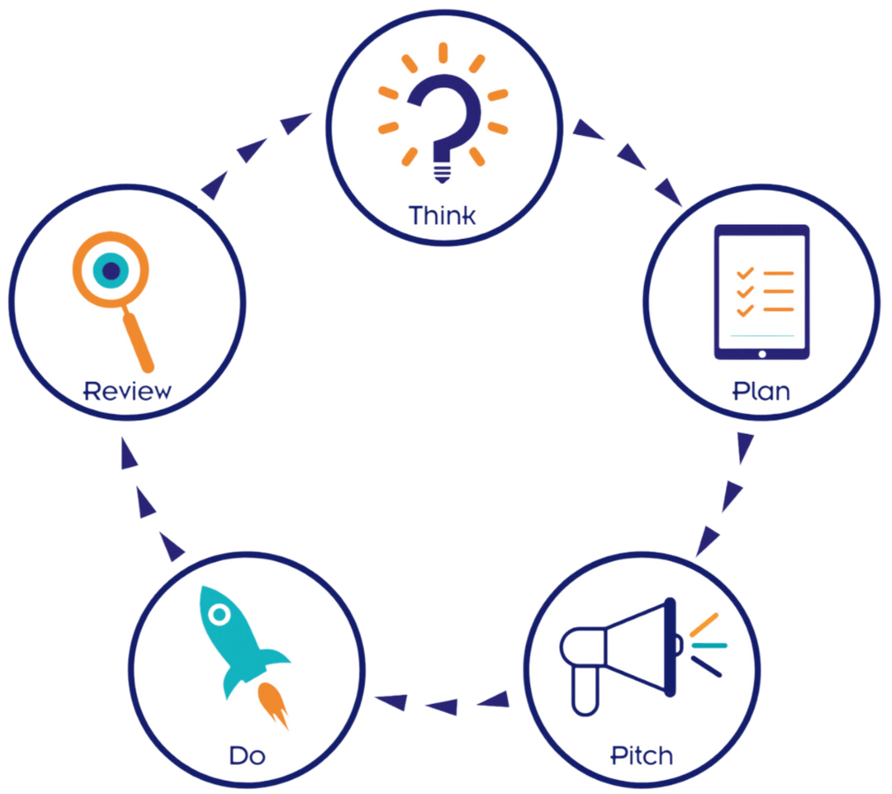

THE PROCESS: THE 5 KEY+ STEPS
THINK IT
PLAN IT
PITCH IT
DO IT
REVIEW IT
Notes:
The project will work as fast or as slow as the group and you as the facilitator want it to. The process is replicated at the beginning of the workbook and can be used as a point of reference.
KEY+ in Education is designed to be flexible and fit within your school - use it during lessons, break times, after school, or add it into PSHE lessons - whatever works for you.
If a group are particularly motivated, they can work through the process quickly and independently. However, if they need more support, you can take as long as you need. As long as the group work together, come up with their own ideas and prepare for pitch in their own way, pretty much 'anything goes'.
If a group struggle with written work, you can support them by scribing, but it's always good to show that the work is their own - if they make spelling or grammatical errors, it's not important, so long as they can get across what they want to do at the panel.
Each step is explained in more detail on the following slides.

Slide 19
THINK IT
Notes:
Step 1: Think It

Slide 20

THINK
You’ll think of ideas with your group and pick one idea that you all want to do.
Guidance
  Share what you all enjoy doing - hobbies, interests, passions.
  Talk about what matters to your group and what you’d like to change or improve.
  Check in and out after each session.
  Brainstorm project ideas - big, small, realistic, wild, everything!
  Come up with a fun, meaningful or quirky team name!
Building Skills
  Explore everyone’s skills and strengths.
  Be honest about what you’re not so good at - these gaps can help shape roles/ideas.
  Discover what you each feel confident doing and what you’d like to learn.
Project Inspiration
  A trip to Infinite Air
  A trip to the Arcades
  Hosting a community fun day
  Creating a short film about a topic your team cares about
  Setting up a fundraiser
  A trip to the beach
Notes:
This is an overview slide, which can be used to explain the 'think' process more thoroughly.

Slide 21
12 KEY SKILLS
Throughout the project, you’ll work towards improving skills.
SELF
RELATIONSHIP
TASK
PERSONAL
RELATIONSHIP
PRACTICAL
Plan your time and energy
Make Decisions
Plan your time and energy
Communicate
Search for information
and get advice
Work out what you're good
and not so good at
Deal with people in
power and authority
Search for information
and get advice
Deal with people in
power and authority
Cope with stress and tension
Cope with stress and tension
Agree your responsibilities
and see them through
Negotiate
Agree your responsibilities
and see them through
Assess your own performance
Assess your own performance
Settle Disagreements
Settle Disagreements
Solve Problems
Solve Problems
Notes:
The skills wheel can be found in the workbooks for young people to fill in.
Use this skills overview slide to explain that the skills are split into three different types and that there will be some that they might be really good at and others they might struggle with - let them know that this is okay. It's normal to have strengths & weaknesses. It might be that they don't think that they've ever used a particular skill, but that they will have the opportunity to have a go at different things while completing the KEY+ Challenge and that you (the facilitator) will be there to support and guide them as much or as little as they need.
Explain that you will go through the skills wheel with them together and explain each skill a little more before asking them to rate themselves out of 10 for each skill.

Slide 22
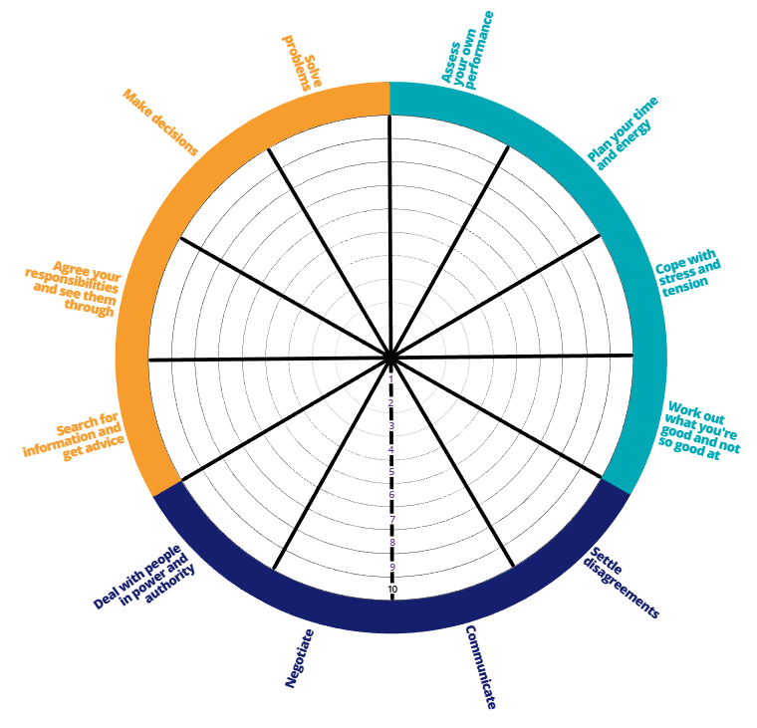
SKILLS WHEEL
Rating your key skills & keeping track of how you are developing these:
1 - NEVER used this skill before
2 - Not confident with this skill
3 - Trying to use this skill but find it incredibly hard
4 - Nervous but see an improvement
5 - Beginning to use this skill more frequently
6 - Used it a little bit but could be more confident
7 - Practising it frequently
8 - Happy using this skill
9 - Comfortable using this skill
10 - Super confident using this skill
Notes:
The skills wheel is numbered 1-10 from the middle of the wheel out.
You can use these prompts to help you explain what each number might mean, to help the young people rate their skills and decide which segment to colour in on the wheel.
Possibly use the traffic light colours to help some young people who might find the wheel a bit confusing:
Red: Not very good
Amber: Okay
Green: Very good

Slide 23





PERSONAL SKILLS
Personal skills are all about managing yourself and understanding your strengths and limits.
Planning Time & Energy
  Are you good at being organised?
  Do you know what you need for school and pack your bag properly?
  Can you make sure you get enough sleep to have energy for the next day?
Cope with Stress & Tension
  Do you have a variety of coping strategies to help you manage your mental wellbeing?
  Do you know what helps when you feel worried or anxious about something?
  Can you manage your frustration and anger before it gets out of control?
Work out what you’re good at and not so good at
  Do you know what your strengths and weaknesses are?
  Do you understand your own skill levels?
Assess Your Own Performance
  Can you accurately guess how you’ve done in a test or know how well you’ve performed in a sport or drama?
  Do you know how to get better and improve?
Notes:
Planning Time & Energy: Discuss how they organise themselves and what strategies help them manage time and energy. Emphasise that different approaches work for different people.
Cope with Stress & Tension: Encourage discussion about handling anger, frustration, or anxiety. Explore the coping strategies they use, which works best for them, and the importance of having a variety of strategies.
Work out what you're good at and not so good at: Ask young people if the skills wheel was easy or challenging. Encourage reflection on what they are good at and what they might need to improve.
Assess Your Own Performance: Explain that being aware of how well you're doing is key. You can perform badly in something but improve if you know what to work on. Similarly, doing well doesn't always mean success if you don't believe in yourself.

Slide 24





RELATIONSHIP SKILLS
Relationship skills focus on how you interact and work with other people.
Communicate
  Can you get your point across in a discussion?
  Can you listen to others without interrupting them?
  Do you feel confident using the phone to talk to people?
  Can you send an email or letter to someone?
  Do you know what’s important to include in a presentation?
Negotiate
  Can you make a deal with someone to get a cheaper or better offer?
  Can you help people to compromise when they disagree or have a different opinion?
Settle Disagreements
  Are you the person to step up and “make up” after a disagreement with friends?
  Do you hold a grudge when you’ve fallen out with your friends?
Deal with People in Power & Authority
  Are you respectful to people (e.g., head teachers, shop keepers, security, police)?
  Do you feel confident when you talk to people who are in charge?
  Can you get your point across to important people, so that they understand you?
Notes:
Communicate: Remind young people that communication isn't just talking to friends. It includes different types of communication in various situations.
Negotiate: Use relatable examples to discuss negotiation, such as:
Haggling for a cheaper price on holiday or at a car boot sale
Persuading a parent to extend curfew by offering to do chores
Finding compromises when people have different opinions
Settle Disagreements: Encourage discussion about resolving conflicts, both small (e.g., who to hang out with, football debates) and larger disputes (friendship arguments). Ask for real-life examples.
Dealing with People in Power & Authority: Help young people identify people in authority (teachers, pastoral staff, police, shopkeepers, councilors) and discuss ways to interact respectfully and confidently.

Slide 25











PRACTICAL SKILLS
Practical skills help you organise tasks and get things done.
Solve Problems
  Can you think of new ways to do things?
  Can you solve mathematical or logical problems?
  If something goes wrong, do you know how to sort it out?
Make Decisions
  Can you make decisions easily? E.g., where to go for a birthday treat, what to wear for a party, who to be friends with.
  Do you consider the consequences of your actions?
Search for Information & Get Advice
  Are you able to use the internet safely?
  Do you know how to find out where somewhere is and how far it is to somewhere else?
  Do you know who you could go to for advice about something?
Agree your Responsibilities & See Them Through
  Do you get homework done on time?
  Do you have jobs to do at home and can you do them without being reminded?
Notes:
Solve Problems: Talk through different types of problems (small, large, logical, practical, mathematical). Use real-life examples like forgetting your PE kit, booking the wrong train ticket, solving a mystery, or doing a Rubik's cube. Encourage discussion about strategies.
Make Decisions: Explain that decisions can be small or big, and sometimes affect others (family, siblings, friends). Invite young people to share examples from their own lives.
Search for Information & Get Advice: Highlight that it's not just about searching online, but reading carefully, navigating websites, checking costs/opening times, and asking the right questions of people to get useful advice.
Agree Responsibilities & See Them Through: Prompt young people to reflect on their responsibilities, whether they remember them easily or need reminders, and discuss ways to follow through.

Slide 26

KEY+ GROUP NAME
Think of a team name for your group! It doesn’t have to be anything related to what you might want to do, just make sure it isn’t offensive. Here’s some examples:
Terry’s Cucumber Dinosaur Squad
The fallen order of the golden Greggs pasties
Dave from Marketing
The Quackers Ducks
Butter Chicken
The Krispie Kremers
Not Fast but Furiously Slow
We can better than a can canner can can a can
Animals in Outer Space
Testing 1234
Smells like TEAM Spirit!!!
The Kurt Cobeans
Notes:
This is the part that lots of young people struggle with.
Encourage them to get creative and tell them that The Key have an award for the Best Team Name - tell them that people who work with The Key decide who wins and that the previous winners include groups that were called The Kurt Cobeans and Everybody and a guy named Kevin.
A good starting point might be things they have in common or just something they think sounds fun. You can use paper and pens for them to write or draw their ideas down, especially if they don't feel comfortable sharing their ideas verbally to start with - then you can read them out.
If they are struggling to agree on a name, encourage the young people to think of a fair way of making a decision. Will they have a vote? Will the most votes win or will they rule out other names first? Highlight the skills they are using to agree on a team name.

Slide 27
PLAN IT
Notes:
Step 2: Plan It

Slide 28

PLAN
You’ll plan how your project will work, you’ll sort all the details; what you need, how to use your budget and who does what.
Research Your Idea
  Look up your activity/place and where it is.
  Check opening times, distance, and any rules.
  Decide how you’ll get there (travel/parking).
Budget & Costs
  Find out the cost per person and total cost.
  Include extras like travel or food.
  Think about asking for a discount or group rate.
Timing
  Choose when you’ll go (school day/term time/after school/weekend).
  Check how long it takes and if you need to book.
Roles & Responsibilities
  Decide who does what based on their skills.
  Share tasks like research, costing, booking, and planning travel.
Notes:
Another overview slide which can help explain the plan part of the process and details all the different aspects to planning that they will have to cover.

Slide 29

PLAN: REMEMBER
  The project is what you want to do and that you all agree on - you can talk about your ideas, do individual research or work in smaller groups.
  All group members need to be involved, whether you work together on a shared laptop or computer or are involved in decision-making.
  This project needs to be safe & legal - these might be things school won’t let you do.
  Everyone needs to reflect on Key Skills they are learning and developing.
  The project must have a clear aim which is shared by everyone.
Notes:
This slide is helpful in reminding the young people what they need to consider when planning.
Make sure the young people know from early on in their planning what school won't let them do - for example, what is the school's policy on risk and activities which may require a waiver signing by a parent or guardian like trampoline parks, climbing, water activities or activities which involve combat, like paintballing or laser tag?
If you school does allow 'risky' activities, encourage the young people to think about the risks and do their own risk assessment. They don't have to write it down but having a discussion about what the risks might be and how they can be minimised.
The aim of the project might be to have fun but encourage the young people to think about what else the aims could be. Including building friendships, increasing confidence and improving skills.

Slide 30

PLAN: BUDGET
In this section, we’ll look at budgeting for your project and share some helpful tips and guidance to make your planning easier!
  Use a table to set out your budget.
  Make sure you break everything down to individual costs.
  Each journey should be accounted for with separate costs for adults and children or miles travelled.
  You will need to cost miles travelled in a car or mini bus at 45p per mile.
Item
Price per
item
Quantity
Total cost (£)
Self raising flour
Sugar
Butter
Eggs
Chocolate
Chocolate chips
Marshmallows
Digestives
Lemons
Sprinkles
Trays
Muffin cases
Facepaints
0.45
1.60
1.55
1.68
1.79
0.50
1
1.29
0.79
2
6
1.79
10
10
10
20
15
20
25
25
10
5
5
5
3
3
4.50
16
31
25.20
35.80
12.50
25
12.90
3.95
10
30
5.37
30
Total costs
242.22
Notes:
The workbook has a blank table set out for the young people to fill in for their budget - this is a great way to support the young people to think about individual costs.
Encourage the young people to think about how they can reduce costs: can they contact a venue and ask for a discount? Is it cheaper to go on a specific day or time? What can they do if a website doesn't have specific food costs? (this can be really common).
Remind them they might have to pay for the adults accompanying them!

Slide 31
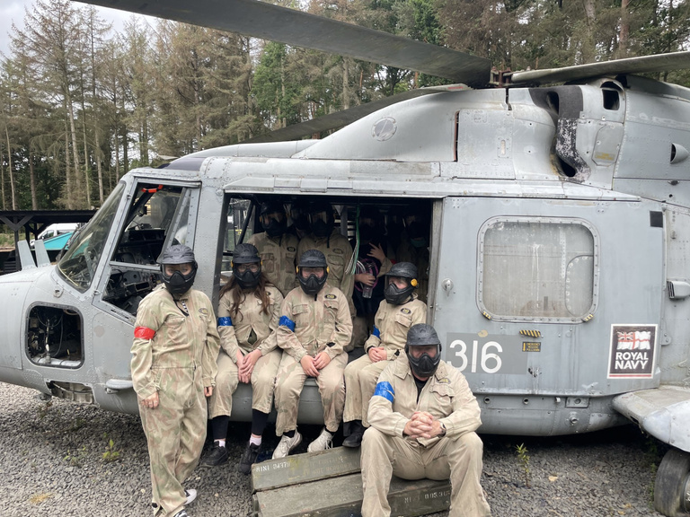
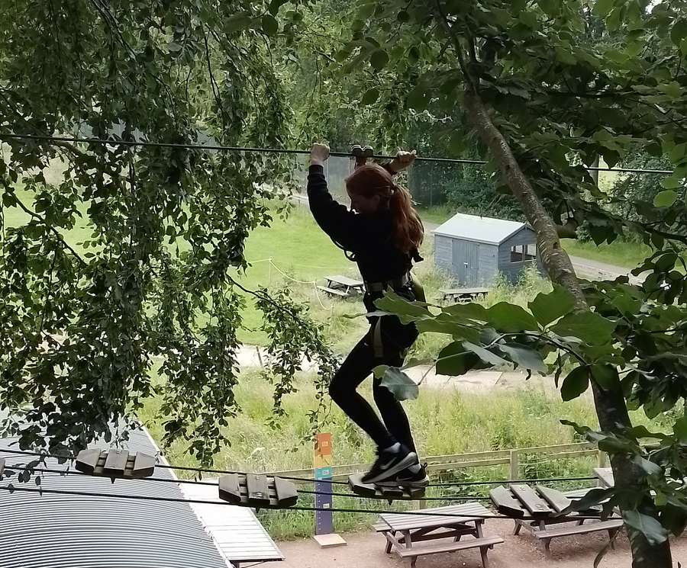
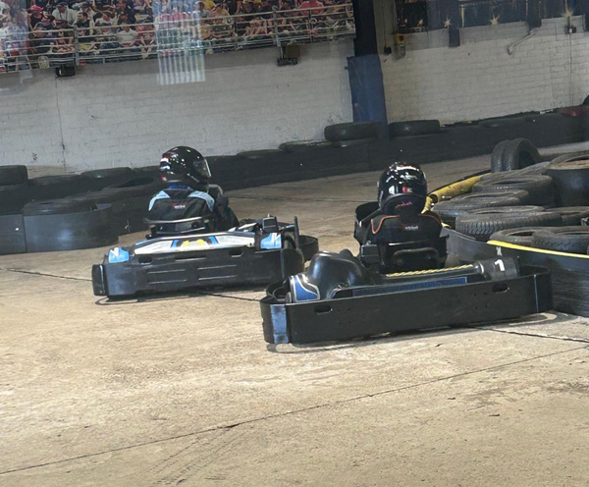
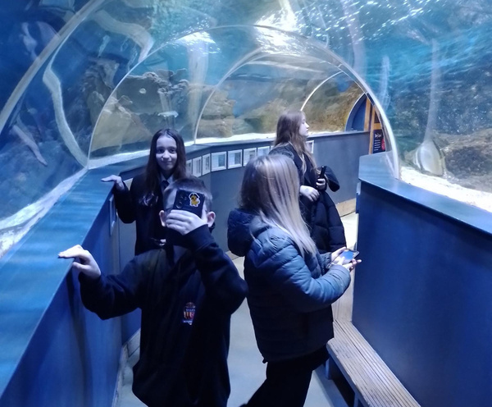
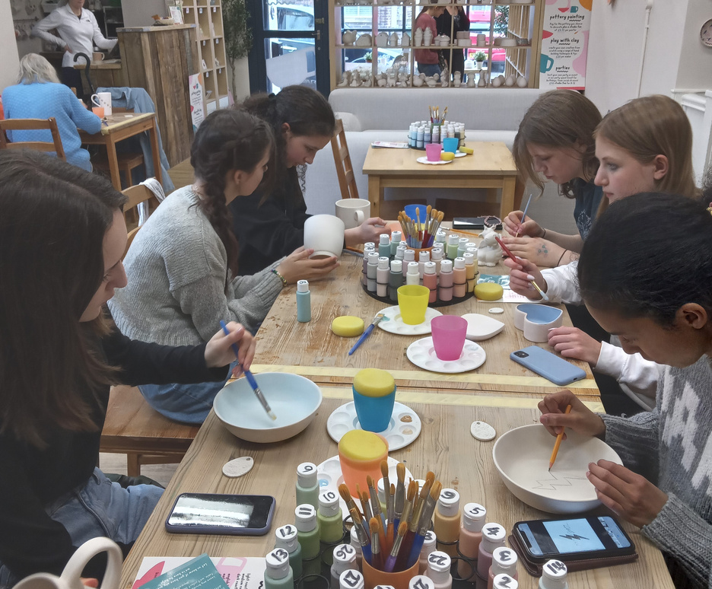
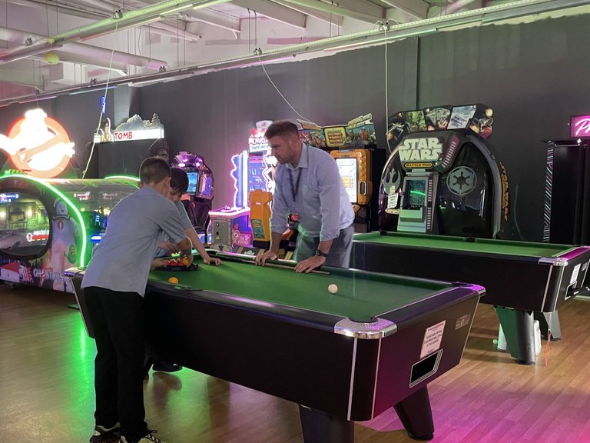
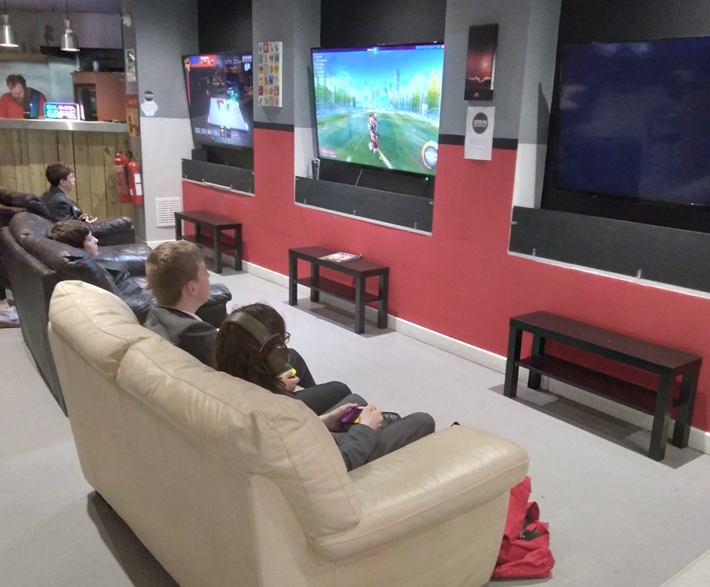
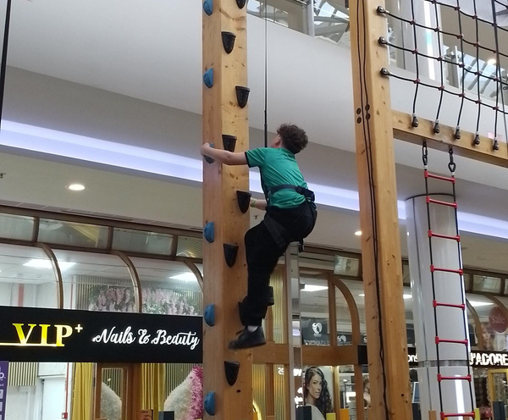
KEY+ STAGE 1 INSPIRATION
Here’s some Stage 1 project inspiration - a snapshot of each idea to spark your own creativity.
Notes:
Inspiration & Planning Tips:
This section provides ideas to help young people plan their KEY+ Challenge projects and explore options:
Escape Rooms: Check what these involve and see if youth discounts are available; encourage research rather than giving all the answers.
Football Stadium Tours: Make provisional enquiries if on a tight timetable; ask venues to hold spaces until project approval.
Tabletop Games/Pool/Bowling: Encourage thorough research of availability, cost and timing.
Shopping Centres: Encourage route planning and timing; consider proximity to other activities.
Other tips:
Venue Considerations: Check opening times, costs, discounts, and ticket rules; think about what else is nearby and if multiple activities are feasible.
Outdoors: Have a back-up plan for bad weather.
Travel: Check minibus availability, drivers, parking and travel costs (45p per mile).
Food Venues: Research prices, drinks, deals, allergies, and dietary/cultural requirements.
These tips encourage young people to develop skills like budgeting, research, organisation and teamwork, while giving them the confidence to plan their own KEY+ Challenge project.

Slide 32
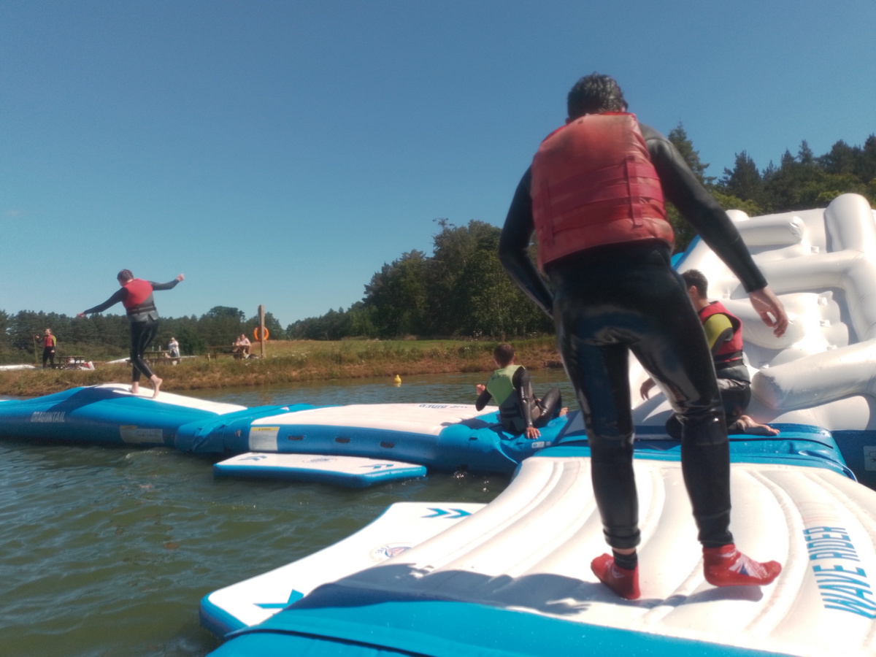
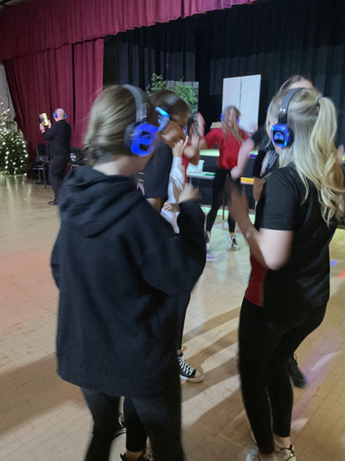
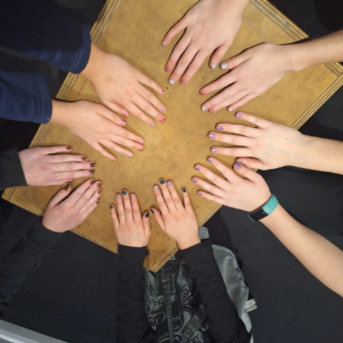
KEY+ INSPIRATION
The KEY+ Challenge doesn’t stop at one stage, there are 3 stages, with each stage providing a bigger budget. Here are some inspiring project ideas across the stages!
Stage
Stage
Stage
1
2
3
TEAM: SIGMA ADELL
TEAM: ASPIRE
TEAM: THE FIVE GEMS
This group built communication, teamwork, and problem-solving skills while helping each other on the Fox Lake inflatables.
This team made the Year 11 Christmas event a hit with a silent disco, taking charge of research, pricing, and event planning.
This team created a song to spread awareness of Type 1 and Type 2 diabetes, working with The Bunker CIC to bring it to life.
Notes:
Inspiration & Planning Tips:
This section provides ideas to help young people plan their KEY+ Challenge projects and explore options:
Escape Rooms: Check what these involve and see if youth discounts are available; encourage research rather than giving all the answers.
Football Stadium Tours: Make provisional enquiries if on a tight timetable; ask venues to hold spaces until project approval.
Tabletop Games/Pool/Bowling: Encourage thorough research of availability, cost and timing.
Shopping Centres: Encourage route planning and timing; consider proximity to other activities.
Other tips:
Venue Considerations: Check opening times, costs, discounts, and ticket rules; think about what else is nearby and if multiple activities are feasible.
Outdoors: Have a back-up plan for bad weather.
Travel: Check minibus availability, drivers, parking and travel costs (45p per mile).
Food Venues: Research prices, drinks, deals, allergies, and dietary/cultural requirements.
These tips encourage young people to develop skills like budgeting, research, organisation and teamwork, while giving them the confidence to plan their own KEY+ Challenge project.

Slide 33





AGREE RESPONSIBILITIES
Once you’ve agreed your project - make sure everybody has a job to do... examples of jobs include:
THE NEGOTIATOR
THE PROBLEM SOLVER
THE RESEARCHER
THE PLANNER
Notes:
Use this slide to encourage the young people to think about what everyone will do.
Who is going to do what and why?
Are they willing to push themselves outside of their comfort zone?
Where do they feel their strengths lie, and what would they like to try that they haven't done before?
Examples of jobs within the group:
Booking venues
Writing the budget
Being creative with the pitch
Working on travel details (distance & cost)
Confirming opening times and prices
Identifying key skills
Remind the group that there is a section in the workbook to support them in organising roles and responsibilities. Encourage discussion and reflection to ensure everyone has a chance to contribute in a way that builds their confidence and skills.

Slide 34
PITCH IT
Notes:
Step 3: Pitch It

Slide 35

PITCH
You’ll pitch your idea and plans to a panel of volunteers to get the go ahead.
Roles & Responsibilities
  Each young person should take responsibility for part of the pitch and plan how they’ll present it.
  Have a backup plan in case someone doesn’t want to speak on the day.
Practice and Preparation
  Practice delivering your part with the group before the pitch.
  Plan how you will pitch - creatively, presentation, props, visuals, etc.
Team Support
  Be supportive and encourage anyone who is nervous or anxious.
  Create top tips to help each other cope with nerves on the day.
Notes:
A series of overview slides to help explain the pitch part of the process to the young people.

Slide 36
PITCH
You’ll pitch your idea and plans to a panel of volunteers to get the go ahead.
Guidance
  Introduce the group - team name and members.
  What is your project?
  Why did you choose it?
  What key skills have you gained?
  What key skills will you use during the rest of the project?
  Show the budget - broken down with clear costs.
  How is the project safe and legal.
Ways to Pitch Your Idea
  PowerPoint
  Flipchart paper
  Posters
  Write a song
  Write a poem
  Act out a play/use puppets
  Create a video
  Use flashcards
  Be creative
Notes:
Pitching your project builds on the planning work but is a separate step in the project.
You can use the workbooks to help you plan the pitch, but this slide is a helpful tool to get the young people to decide which part they would like to prepare.
The workbook has suggestions of how to present, from PowerPoint to Flip Chart Paper, being creative with a song or poetry or getting creative with interactive artwork... Explain to the young people that they don't all have to use the same medium - if some want to be more creative and others want to stick to something simple; they can do that!
Encourage young people to talk about what they would and wouldn't feel comfortable doing. It's helpful to remind the young people that just because they are preparing a particular part of the pitch, doesn't mean they have to present it on the day. Focusing on creating and owning their part of the work can give them pride in what they have done, and even the most nervous or anxious participants may feel more confident to share with the panel once they're in the room.

Slide 37
PITCH: TOP TIPS
  It’s okay to be nervous! It means you care.
  Make sure you practice what you want to say.
  Try to look at the panel members when you’re talking but don’t worry if you can’t.
  The people on the panel are really nice - they just want to find out about your project!
  The panel WILL ask you questions - they just want to make sure it’s your own work and they want to know why you have chosen to do it.
Notes:
Use this slide to help reassure the young people who will feel nervous about their pitch.
Try out some practice questions the panel members might ask the young people. For example:
What has been the hardest part of the project?
Tell us about any disagreements you might have had?
How have you found the budgeting?
How have you made sure everyone had a role to play?
What skill do you think you've improved the most?

Slide 38

PITCH SUCCESS!
YOU GOT THE YES?!!! YOU SMASHED IT!! NOW GET BOOKING AND PLANNING THE DAY.
REMEMBER: HAVE FUN!
Notes:
It's important to make sure you celebrate the young people being successful at panel!
Recognise their group achievement as well as their individual achievements, particularly if they have overcome a fear or anxiety. If you're able to, maybe have a small treat to reward their hard work.
Recognise their achievement in whatever way you can - does your school give merits, house points, colours, or any positive reinforcement for hard work?
Remember, some young people might not thank you for recognising their hard work in front of others, while others will revel in it. Keep it relevant to the group and ask them how they would like to receive recognition in school.

Slide 39
POST-PANEL BOOKING & PLANNING TIPS
Booking
  Book the activity you’ve planned either online or by phoning to confirm a previous enquiry.
  Make a payment over the phone or online using your facilitator’s card details.
  Some establishments may as you to pay on the day.
Planning
  Plan a route and work out exact travel times, including driving and public transport.
  Work out how long you need to order food (if you are going out for food) and other preparations.
  Decide what time you need to get back to school.
  Confirm which staff members will accompany you on the trip.
Notes:
The workbooks have a page dedicated to planning the timings of activities which can be a really helpful starting point for the young people.
Encourage them to think through what their day will look like from start to finish - what time and where will they need to meet and how long will each thing they have planned take? It's important to really let the young people take control - if you think they're making a mistake, ask them if they've really thought about it or what they would do if X or Y happened, this will encourage them to think through any potential problems and have a back up plan.

Slide 40
TIMINGS EXAMPLE
Activity
Location
Start Time
Finish Time
Meeting at school
Meeting at
school
10:00am
Walk to bus stop
Gateshead
10:00am
10:20am
Get the bus to Go-Karting
Gateshead to Newcastle
10:30am
11:00am
Do Go-Karting
Team Sport Go-Karting, Newcastle
11:15am
12:30pm
Get food from Nando’s
Nandos Newcastle
12:30pm
1:30pm
Walk to bus stop
Newcastle
1:30pm
1:40pm
Get bus to bus station
Newcastle to Gateshead
1:45pm
2:15pm
Walk from the bus station back to school
Gateshead
2:15pm
2:35pm
Notes:
Here is an example of what the timings grid looks like in the workbooks. It is a useful guide for the young people.

Slide 41
DO IT
Notes:
Step 4: Do It

Slide 42

DO
You’ll now do your project, bringing your idea to life. HAVE FUN!!
Preparation & Organisation
  Book your activity and make sure everything is in place so the day goes smoothly.
  Make sure everyone has a job or responsibility on the day.
  Nominate someone to be in charge of directions, timings, and safety.
Taking Charge/Leadership
  You’re in charge, not the adults - approach venue staff and introduce yourselves.
  Try to let everyone have a go at paying for something or introducing the group.
  Try to step out of your comfort zone while remembering adults are there to help.
Recording & Evidence
  Keep a record of the day - take receipts, pictures or videos.
  Remember to ask for reciepts for everything.
Notes:
A slide explaining the do part of the project in more detail.
While it might seem obvious that the young people will do their project, it is important that they take the lead and that they know they are in charge of the day!
Support the young people to assign jobs to do on the day, they can include:
Talking to venue staff to introduce themselves when they arrive
Working out directions when walking from one place to another
Buying tickets for travel or parking on the day
Ordering and collecting food from takeaway food establishments
Speaking to venue staff about any mistakes with orders
Entering information into games where they need to
Making sure the group is safe on the day (checking if everyone has their seatbelts on, or is crossing the road safely)
Getting receipts for everything they spend money on
Making sure the group stays on track with timings
Rather than doing what comes naturally, keeping everyone in check, ask the young people if they need to do anything and continuously encourage them to take the lead and speak to the people they need to.
As a facilitator, it's important to try and leave the 'school head' at school and really embrace the fact that the young people are in charge - if something goes wrong, can they deal with it? Try not to solve the problems for them, allow them the time and space to work it out for themselves - use choices and options if they are struggling.
While it's also great for facilitators to take pictures and videos for evidence, it's also impactful if the young people can have a role in this too. What parts of the day are worth capturing? Let them decide! And do they want to say anything (voice note or video) about what they are doing?

Slide 43
REVIEW IT
Notes:
Step 5: Review It

Slide 44

REVIEW
Finally, you’ll come together to review your project, reflecting on what went well, what you learnt and the skills you’ve built along the way.
Reflecting on the Project
  Reflect on your project from beginning to end.
  Think about what you enjoyed and what was difficult.
  Try to be honest about your experience and challenges.
Skills & Personal Growth
  Complete your second skills wheel to see where you’ve grown and developed.
  Look at where you’ve made progress and which skills improved the most.
Evaluation & Questions
  Answer the evaluation questions about what you achieved.
  Complete the workbook questions to reflect as individuals and as a team.
Group Discussion
  Take part in group reflection questions using flipchart paper or our evaluation poster.
  Use agree/disagree statements to explore everyone’s views and experiences.
Notes:
A few slides explaining the review part of the project in more detail.
This is a significant part of the project and it's important that it is not missed or skimmed over.
The young people should come together one last time to reflect on everything they have done and achieved - it's an opportunity for them to feel proud of what they have done and recognise any obstacles and challenges they have overcome.
Use the workbook to fill in the skills wheel and encourage the young people to talk about where they have made progress. They should also note if there are any areas they would like to continue to work on. You can refresh about rating out of 10 if that is easier for the young people. You, as the facilitator, should also feedback where you have seen changes in them.
If the young people struggle to sit and focus, use the room as a continuum and make statements or ask questions where they can agree or disagree by moving to different parts of the room. Make notes as a facilitator about their feedback to avoid them having to do too much written work.
Suggested statements (remember - you do not need to use all or any of these). As a result of being involved in the KEY+ Challenge:
I have made new friends
My confidence has grown
I have learnt something new about myself
My skills have developed
My behaviour has improved
I find it easier to organise myself
I will volunteer to help out in school

Slide 45
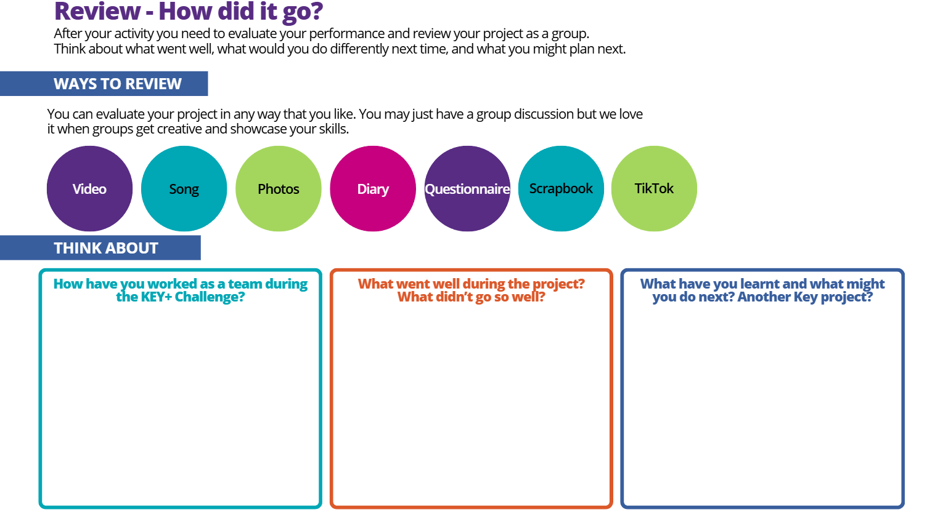
Notes:
Here is an example of a page in the workbook that can help the young people reflect on the project.

Slide 46
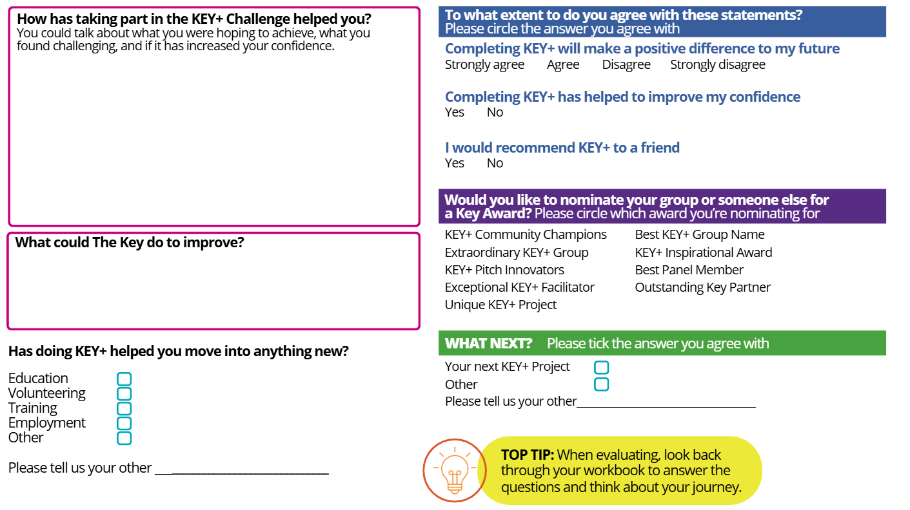
Notes:
Here is an example of a page in the workbook that can help the young people reflect on the project.

Slide 47

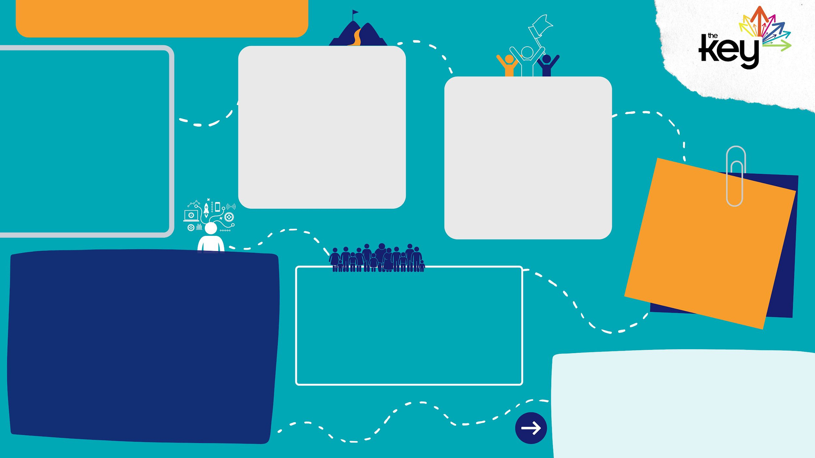







NAME
SUMMARY
The challenges we faced
The activity we chose
What new experiences have you had?...
The skills we built
What have you learnt?
Stage 3 here we come…
Notes:
Here is an evaluation poster that the group can use to reflect on the project together. This is also included in the KEY+ resources.

Slide 48







FACILITATOR FEEDBACK
A summary of what the group did
The challenges the group faced
What went well for the group
How the project helped everyone
The skills the group improved
How being part of a team helped friendships
Are they ready for the next stage?
Notes:
The Key will ask you to upload your feedback to the facilitator feedback session on KIT.

Slide 49
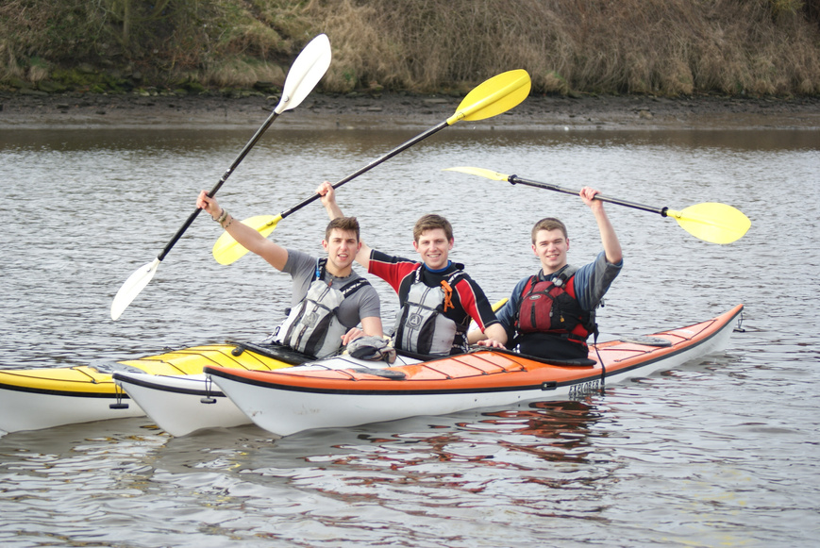
KEY CONTACTS
Leah Roberts: leah@thekeyuk.org
Jack MacKenzie: jack@thekeyuk.org
Sari Sokell: sari@thekeyuk.org
thekeyuk.org
Notes:
Please get in touch with The Key staff for any questions, queries or support needs.

